Slide 1
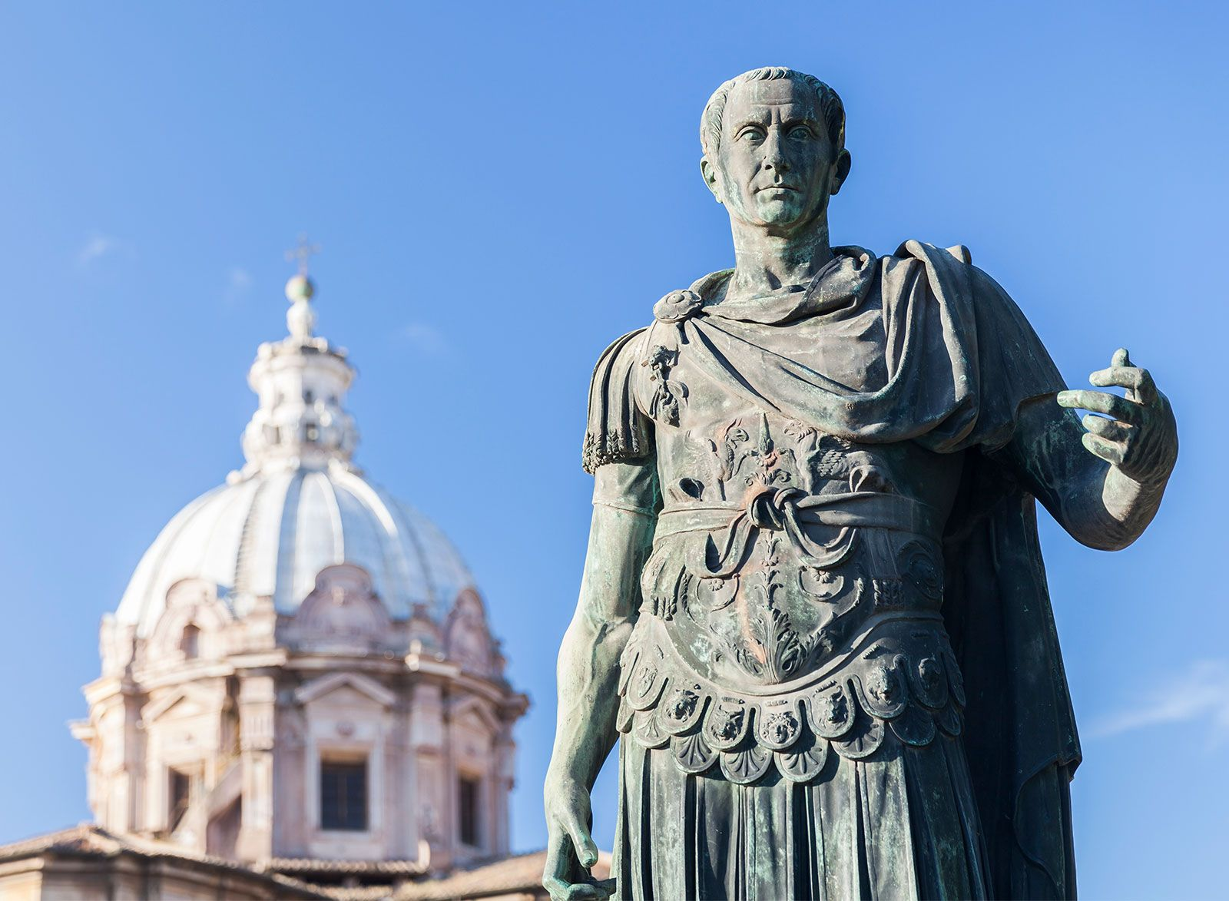
Essay Prep
REVIEW ESSAY WRITING
Week 9 Lesson 2
Ms Barrie

Slide 2

Discussion Question:
What makes a good essay?

Slide 3
A good essay will…
Answer the question
Have a clear argument
Use a clear structure
Use evidence to support points
Be written legibly
Use historical terminology
You must pretend I know NOTHING about this topic.
You must write clearly to TEACH me about it, and use evidence to support what you are saying…
… otherwise, why would I believe you?

Slide 4
Your essay
Introduction
Thesis Statement
Background information (a brief statement)
Essay Map
Body Paragraph 1
Body Paragraph 2
Body Paragraph 3
Conclusion
You will be required to write a 5 paragraph essay
You will have the choice of three questions.
45 minutes
Approx. 9 minutes per paragraph

Slide 5
ACTIVITY – 3 topics
A3 sheet – 3 topics
Write everything you know about each of these topics!

Slide 6
Essay Prep
REVIEW ESSAY WRITING
Week 9 Lesson 3
Ms Barrie

Slide 7
ACTIVITY 1 - Reflect
Get out your assessment folder and first essay (Task 2)
Read through what you wrote and the feedback/marking key
What is ONE area you can improve on for this upcoming assessment?

Slide 8
ACTIVITY 2 - Analyse Sample Essay
Read through the sample essay provided for the following topic
Discuss 3 (THREE) key events that occurred in Julius Caesar’s life that allowed him to gain power in the Late Roman Republic.
Using the marking key provided, mark the test
Highlight the following:
Thesis Statement
Topic Sentences
Evidence

Slide 9
INTRODUCTIONS: Thesis Statements
Read through the essay question – what is your answer or response to that question? THAT is your thesis statement.
For example:
Leadership: "Julius Caesar's exceptional leadership qualities, demonstrated through his military successes, political acumen, and ability to inspire loyalty, played a pivotal role in his rise to power and his enduring impact on the Late Roman Republic.”
Impact on the Roman Republic: "Julius Caesar's influence on the Late Roman Republic was transformative, as his military conquests, political reforms, and eventual dictatorship reshaped the political landscape, leading to both admiration and resistance, ultimately paving the way for the Roman Empire."

Slide 10
INTRODUCTIONS: Background Info
Provide brief background information about your thesis statement. Use at least 1 key person, event, and idea.
For example:
Julius Caesar
Born/died
Parents
Who he is and what he did

Slide 11
INTRODUCTIONS: Essay Map
Julius Caesar, one of the most iconic figures in Roman history, played a pivotal role in the transformation of the Late Roman Republic into the Roman Empire. His ascent to power was marked by several key events that showcased his exceptional leadership, political acumen, and charisma. This essay will discuss three crucial events in Julius Caesar's life that allowed him to gain power during the Late Roman Republic.

Slide 12
ACTIVITY - Plan your structures!
You have the three essay topics.
Plan your structures:
Intros
Body Paragraphs – evidence!
Conclusions

Slide 13
ACTIVITY – Finding Evidence!
For each of the 3 topics, find at least ONE piece of evidence that can be used to support your claims.
They can be:
Historian’s perspectives
Data/Statistics
Quotes/Speeches

